Slide 1
Single Unit Transfusion for Red Blood Cell Transfusion
Based on the Patient Blood Management Guidelines
Every ONE matters
Notes:
Introductory Slide – Establish context of single unit transfusion policy in over-arching restrictive transfusion and patient blood management framework.
The catch phrase “Every ONE matters” is used in these slides. You may wish to substitute it for another phrase e.g. “ONE bag is best the reassess” or “Be SINGLE minded”

Slide 2
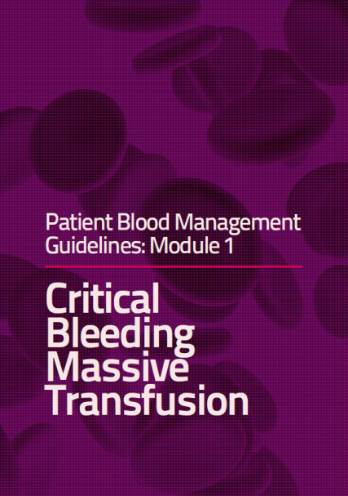
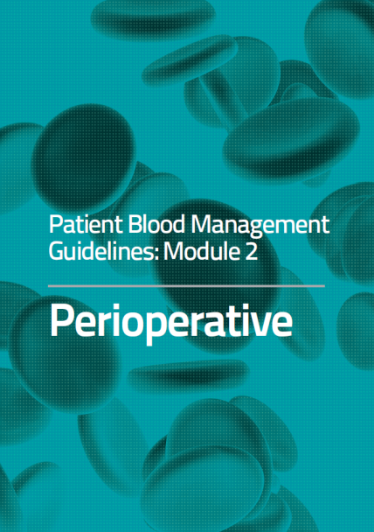
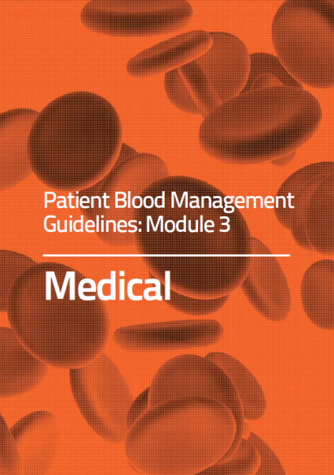
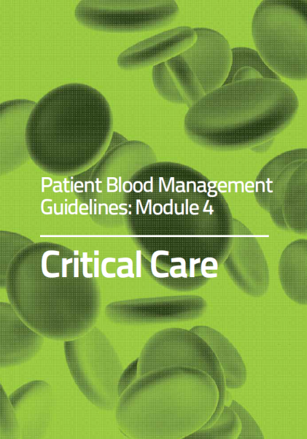
Patient Blood Management Guidelines
www.blood.gov.au
www.blood.gov.au/pbm-guidelines

Slide 3
Single Unit Transfusion
WHO
The stable, normovolaemic adult inpatient who does NOT have clinically significant bleeding with symptoms of anaemia
Haemoglobin as defined in the Patient Blood Management Guidelines www.blood.gov.au/patient-blood-management
Notes:
Background: Specific patient group – excludes actively bleeding patient, and patient in theatre.
Emphasis on individual patient assessment for each unit – NOT transfusion according to Hb alone, or traditional request for 2 units.
Evidence based Patient Blood Management Guidelines: Module 3 - Medical and Module 4 - Critical care patients available to guide appropriate Hb levels.
The evidence-based Patient blood Management Guidelines^{4,5} state the haemoglobin transfusion thresholds as:
Hb concentration <70 g/L, RBC transfusion may be associated with reduced mortality and is likely to be appropriate. However, transfusion may not be required in well compensated patients or where other specific therapy is available.
Hb concentration of 70 – 100 g/L, RBC transfusion is not associated with reduced mortality. The decision to transfuse patients (with a single unit followed by reassessment) should be based on the need to relieve clinical signs and symptoms of anaemia, and the patient’s response to previous transfusions. No evidence was found to warrant a different approach for patients who are elderly or who have respiratory or cerebrovascular disease.
Hb concentration >100 g/L, RBC transfusion is likely to be unnecessary and is usually inappropriate. Transfusion has been associated with increased mortality in patients with ACS.
For patients with acute coronary syndrome (ACS), the evidence-based Patient Blood Management Guidelines^{4,5} state transfusion haemoglobin thresholds as:
In patients with ACS and a Hb concentration <80 g/L, RBC transfusion may be associated with reduced mortality and is likely to be appropriate.
In patients with ACS and a Hb concentration of 80 – 100 g/L, the effect of RBC transfusion on mortality is uncertain and may be associated with an increased risk of recurrence of MI. Any decision to transfuse should be made with caution and based on careful consideration of the risks and benefits.
In ACS patients with a Hb concentration >100 g/L, RBC transfusion is not advisable because of an association with increased mortality.

Slide 4

“Every ONE matters”
WHAT
Transfuse one unit, then reassess the patient for clinical symptoms before transfusing another
  Every unit is a new clinical
  decision
  Base decision on patient
  symptoms, not only on
  haemoglobin

Slide 5
Single Unit Transfusion
WHY
It is important to align practice with the national Patient Blood Management Guidelines
Transfusion may be an independent risk factor for increased morbidity, mortality and length of stay.
Potential harm from transfusion is dose dependent
Transfusion is a live tissue transplant
The British Committee for Standards in Haematology (2012). Guidelines on the Administration of Blood Components. Addendum to Administration of Blood Components, August 2012 pdf. http://www.bcshguidelines.com/4_HAEMATOLOGY_GUIDELINES.html
Carson JL et al. 2012. Transfusion thresholds and other strategies for guiding allogeneic red blood cell transfusion – Cochrane Review. Cochrane Database of Systematic Reviews 2012: Issue4
Hofmann A, Farmer S, Shander A. 2011. Five Drivers Shifting the paradigm from Product-focused Transfusion Practice to Patient Blood Management” The Oncologist 2011;16(suppl 3):3-11
Hofmann, A et al. 2012. Strategies to preempt and reduce the use of blood products: an Australian perspective. Curr Opin Anesthesiol 2012, 25:66-73.
Notes:
National Safety and Quality in Health (Standard 7: Blood and Blood Products) require blood and blood product policies and procedures to be consistent with national evidence based guidelines for pre-transfusion practices, prescribing and clinical use of blood and blood products.
Recent scientific literature supports transfusion is an independent risk of increased morbidity, mortality and hospital length of stay. The risk of harm is dose dependent – every unnecessary unit transfused represents an imbalance towards risk, not benefit.
The ageing population represents BOTH an increasing demand for blood products, and a reduction in the available eligible blood donors.
The cost of blood transfusion is many multiples of the cost of the product itself (estimated at 4.8 times cost of unit). Significant and growing impact on health budgets.
Apart from in the actively bleeding patient, there is a lack of evidence for benefit of red blood cell transfusion.

Slide 6
Four reasons why excessive transfusion is a problem
Reason 1:
Each transfusion increases the risk of nosocomial infection increases other morbidities
Analysis of 11,963 patients after CABG surgery showed that perioperative RBC transfusion was associated with a dose-dependent increased risk of postoperative cardiac complications, serious infection, renal failure, neurologic complications, overall morbidity, prolonged ventilator support, and in-hospital mortality.
Koch CG et al. Morbidity and mortality risk associated with red blood cell and blood-component transfusion in isolated coronary artery bypass grafting. Crit Care Med 2006, 34: 1608-1616.

Slide 7
Four reasons why excessive transfusion is a problem
Reason 2:
Transfusion requirements after cardiac surgery (TRACS) study prospectively demonstrated the safety of a restrictive strategy of red blood cell (RBC) transfusion in patients undergoing cardiac surgery. Also reported: the higher the number of transfused RBC, the higher was the number of clinical complications.
Hajjar LA et al. Transfusion requirements after cardiac surgery: the TRACS randomised controlled trial. JAMA, 304:1559-1567.

Slide 8
Four reasons why excessive transfusion is a problem
Reason 3:
Transfusion associated circulatory overload (TACO) is among the high risk adverse effects of red cell transfusion (up to 1 in 100 per unit transfused).
National Blood Authority, 2012. Patient Blood Management Guidelines: Module 2 - Perioperative. Appendix B, Table B.2.Transfusion Risks in perspective.

Slide 9
Four reasons why excessive transfusion is a problem
Reason 4:
Perioperative red blood cell transfusion is the single factor most reliably associated with increased risk of postoperative morbid events after isolated coronary artery bypass grafting. Each unit of red cells transfused is associated with incrementally increased risk for adverse outcome.
Koch CG et al. Morbidity and mortality risk associated with red blood cell and blood-component transfusion in isolated coronary artery bypass grafting. Crit Care Med 2006, 34: 1608-1616.

Slide 10
Implementing a guideline
“Every ONE matters”
HOW
Identify key staff / team responsible for implementation
Approval and endorsement - CHAMPIONS
  From Transfusion Governance Committee / Patient Blood Management Committee
  Medical and nursing leadership
  Transfusion Medicine leadership
Notes:
The guideline represents a change to many generations of “habitual or cultural” transfusion – practices passed along unchallenged, but found to be lacking evidence of benefit.
Requires high level support and drive from respected management and senior medical staff – Champions, to give confidence, and demonstrate belief and acceptance of the evidence.
Huge task of education across entire hospital population, requiring staff and resources. (Computerised Physician Order Entry systems could be used to guide decisions, if available). Early education at orientation, and during early training is important.

Slide 11
Implementing a Guideline
“Every ONE matters”
Implementation
  Hospital wide education; medical, nursing, laboratory staff, in all clinical areas that administer blood products
  Encourage clinical champions to spread the message
  Include in orientation education for new staff
  Key messages, visible signage, electronic media, newsletters.

Slide 12
Clinical Support is Vital
Empower and Support
Nursing and Laboratory staff who question the appropriateness of a request for blood must have:
  Documentation of the guideline outlining criteria for a second unit of blood
  Ready access to medical support - Champions to discuss episodes of apparent non-compliance
  Educational material to give to staff unaware of the guideline
Notes:
Empowerment requires support from senior respected medical staff CHAMPIONS to assist in guiding practice. Clinical champions must be available to assist when non-compliance is disputed.
Empowering nursing and laboratory staff also provides an on-going opportunity for dissemination of educational material about the policy. Clear details of inclusion criteria for second unit is important.

Slide 13
Guiding Compliance
Empower and support staff to question prescription / order for blood products
  Laboratory staff, nursing staff, medical staff
  Guideline accessible at prescription point and in laboratory including prompts for questions about compliance
  Inclusion criteria for second unit
Prompt patients to enquire about blood transfusion requirements
Support from clinical champions to resolve challenges to requests
Utilise Computerised Physician Order Entry systems if available to guide transfusion decisions and compliance to the guideline
Notes:
Nurses can influence medical staff if aware of apparent non-compliance to guidelines - IF EMPOWERED.
Laboratory staff can monitor issue of blood, by asking about symptoms, and haemoglobin, suggesting request appears outside the policy – IF EMPOWERED.
Empowerment requires support from senior respected medical staff CHAMPIONS to assist in guiding practice. Clinical champions must be available to assist when non-compliance is disputed.
Empowering nursing and laboratory staff also provides an on-going opportunity for dissemination of educational material about the policy. Clear details of inclusion criteria for second unit is important.
If Computerised Physician Order Entry systems are available, they need to be tailored to separate bleeding patients from non-bleeding, then prompt for symptoms and reasons if more than one units is requested.
Where electronic ordering is unavailable, providing details of the policy at the point of prescription – on forms, or in proximity to forms may help.
Specific information detailing when a second unit is appropriate needs to be available to nursing and laboratory staff.

Slide 14
Collect and Report Data
Data collection
  Statistics from laboratory systems:
    blood packs ordered daily from the Blood Service
    Daily transfusion numbers – units, patients
    Number of single unit transfusions
  Log of non-compliant requests to laboratory / local Incident Management System
  Audit of patient medical record for transfusions
*Please note: incidents, adverse events and near misses should continue to be recorded in your incident management system.
Notes:
Data may be collected manually, or from existing information systems. BloodNet is widely available and can provide number of packs ordered daily from Blood Service. Reporting to Transfusion Governance Committees and wards, divisions, and laboratories is important to monitor progress, acknowledge efforts, and invite comment. Opportunities for feedback to discuss problems and suggestions for changes are important.

Slide 15
Report Data / Feedback
Reporting Progress – Feedback data
  To Transfusion Governance Committee, quality committee, clinical governance / executive
  Medical specialties / divisions, nursing meetings, laboratories.
  Benchmark between departments, hospitals, health services, states.

Slide 16
Review and Feedback
Benchmark internally, locally, externally.
Share statistics and reports with staff
Provide a forum for discussion of difficulties, and seek resolutions to problems
Provide access to articles / reports about progress and new developments
  in single unit transfusion
  Patient Blood Management

Slide 17
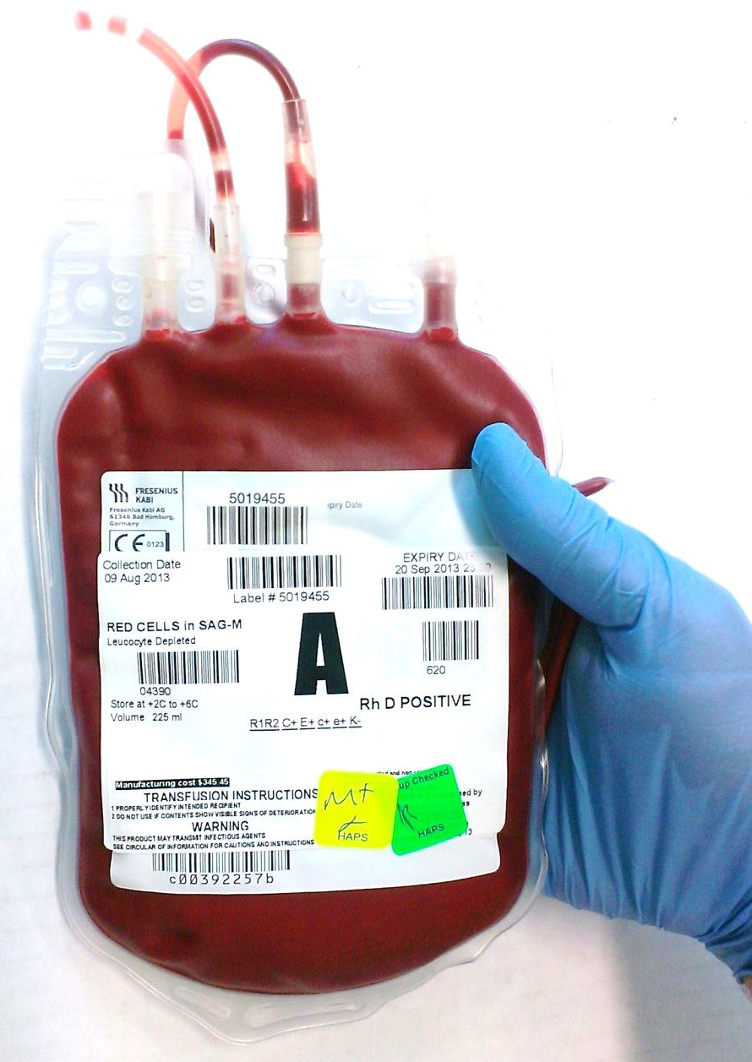
Every ONE matters
                Transfuse One Unit
                Re-assess the patient
                Don’t increase the RISKS
                if
                NO BENEFIT

Slide 18
Single Unit Transfusion Guideline
Benefits: Safer, evidence based transfusion
PLUS:
Reduced risk of non-infectious adverse events
Reduced demand on limited blood supply
Reduced risk from new infectious agents
Every ONE matters
Notes:
The risk and benefit equation must be considered for each unit of blood transfused. There is a lot of evidence of risk, and harm from blood, but very little evidence of benefit in the non-bleeding patient.
Transfusion is an independent risk for nosocomial infection, increased morbidity, mortality and increased length of hospital stay.
The ageing population will increase the demand on blood products, while the pool of eligible donors will decrease.
While blood is extremely safe from the known infectious agents, the threat of new, unknown or re-emerging agents must be considered.
CONCLUSION:
The single unit transfusion guideline will align practice with evidence, and reduce potential harm from unnecessary transfusion.

